Slide 1
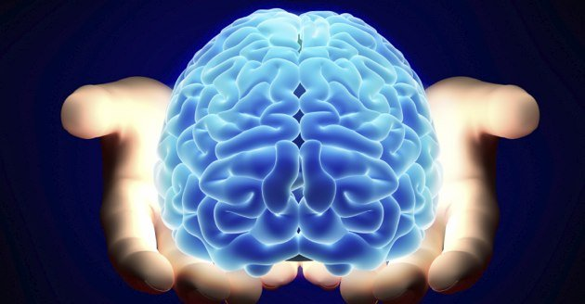
Art, Creativity and the Human Brain
Kenneth Wesson
Educational Consultant: Neuroscience
San Jose, CA
kenawesson@aol.com

Slide 2
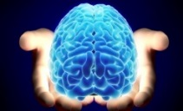
We cannot always build a future for our youth, but we can build our youth for the future.
-- Franklin D Roosevelt

Slide 3

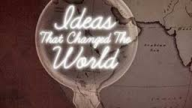
Creative Thinkers
Agricultural Age
    → Industrial Age
    → Information Age
Moving from the Information Age
      → The Innovation Age

Slide 4
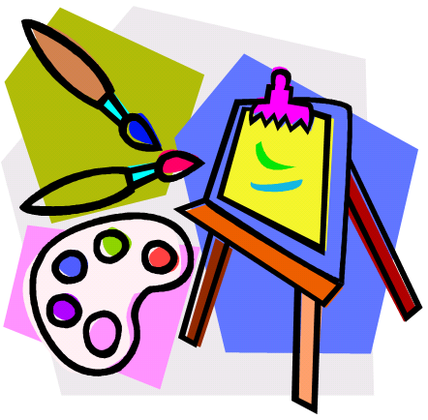

The illiterates of the future are not those who cannot read or write, but those who cannot learn, un-learn, and re-learn.
--Alvin Toffler

Slide 5
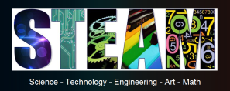
Art, Creativity and the Human Brain
How does our the highly visual brain interact with a world where it learns not only how to think, but how to create?
How do the arts contribute to learning across the curriculum, and to creativity?
(NGSS sketching, drawing, creating models)
…a visual and conceptual tour… (a highly visual brain)

Slide 6

The Biological Brain by the Numbers
Sense Type of Sensory Input
1. Smell Olfactory molecular experience (nose)
2. Hearing Vibrations (air/ear)
3. Touch Tactile contact (feeling/skin)
4. Taste Oral contact with chemicals
5. Sight Visible Light (eyes)
Perceptual convergence
(a single experience – the cooperation and integration of all 22+ senses)

Slide 7
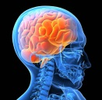
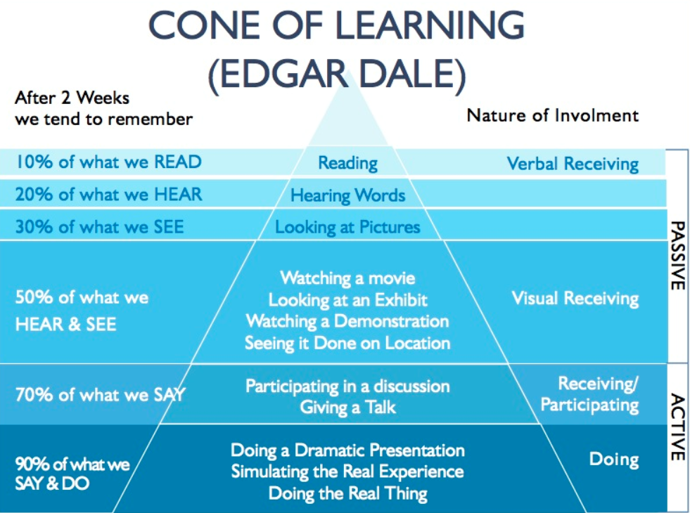

Slide 8
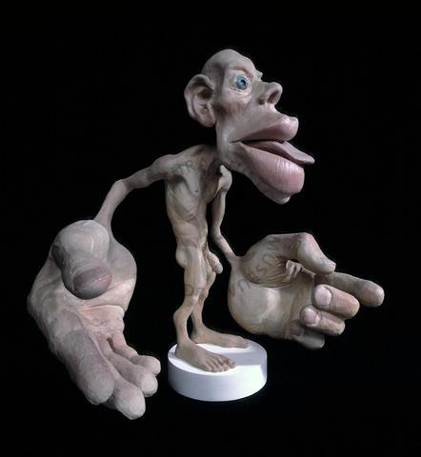
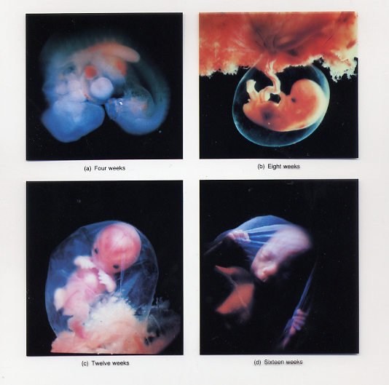
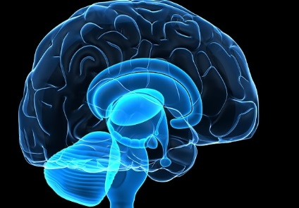
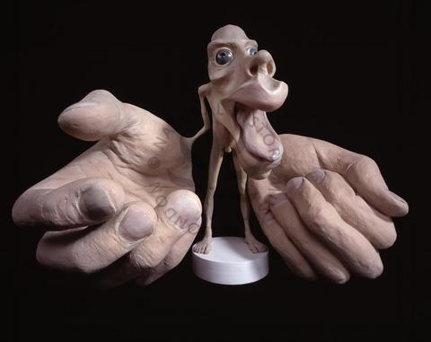
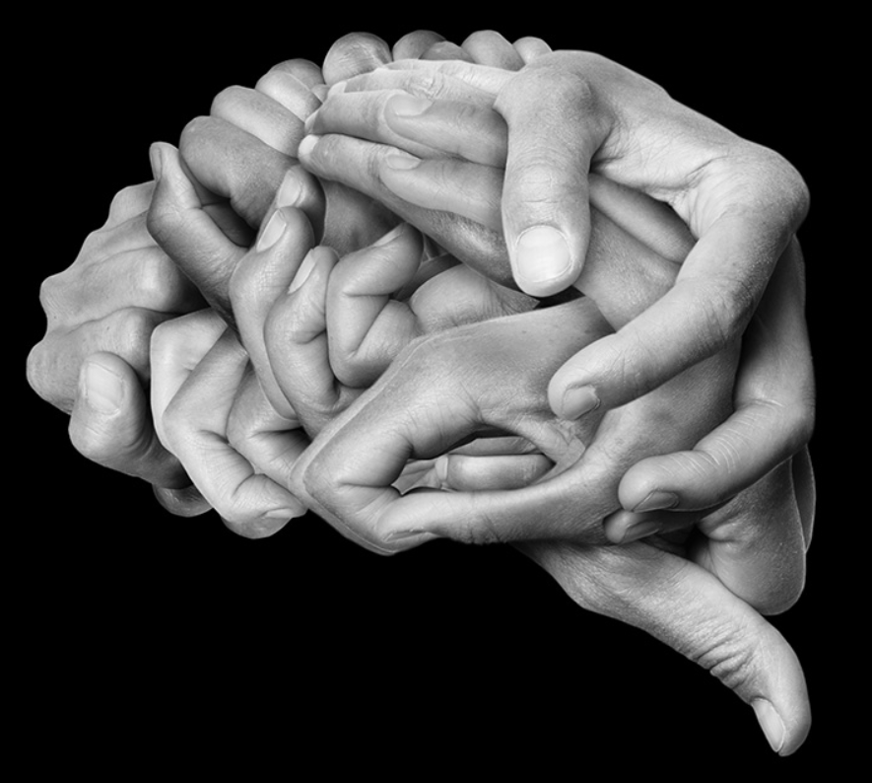
Why is Hands-on Learning Effective? Developmental Neurobiology
Sensory Cortex
Motor cortex
In the “digital age,” it is critical that educators remember that the 10 digits on a student’s hands are the
first human digital devices
(and remain the most powerful).

Slide 9
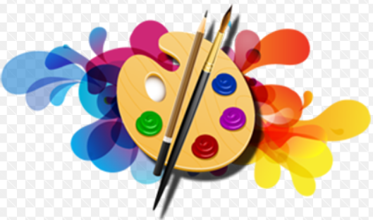
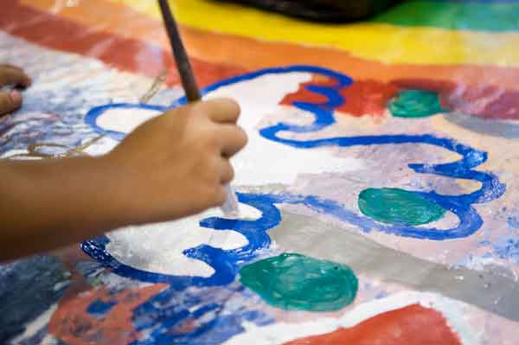
Art and the Brain
The brain regions that are dynamically engaged during art include
  The primary visual cortex - for vision
  The frontal lobes - for decision-making
  The pre-motor areas - for planning physical actions
  The motor cortex - for physical movement
  The temporal lobe - for memory
  The limbic system – the emotional centers
  The association areas – for visuo-sensori-
  motor integration

Slide 10
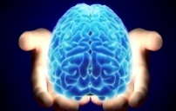
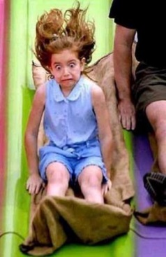
PERC³S
There are five BC elements that the human brain seeks while processing incoming stimuli for personal “meaning,” which makes the information “memorable” and worth remembering.
  Patterns (derivative of visual experience)
  Emotions
  Relevance
  Context, Content, and Cognitively-appropriate
  Sense-making → Stories (narrative)
Patterns, emotions, relevance, context, content and sense-making are critical factors in driving (1) attention, (2) motivation, (3) learning, (4) memory formation, and (5) recall. Collectively, these 5 factors are the primary criteria for transfer into long-term memory storage.

Slide 11
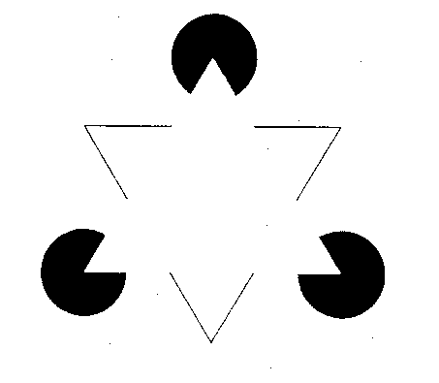

Slide 12
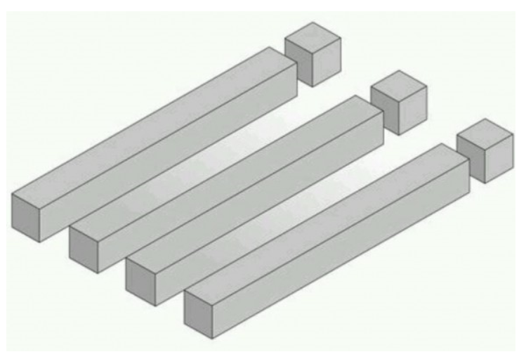

Slide 13

Geons
Circles, spheres, squares, blocks, cylinders, cones, etc., are among the 24 basic “geons” (geometric forms) -- the natural environment.
Simplistic “stick” representations (straight or curved- lines) of these concrete objects elicit a mental reminiscence of the “real thing.”

Slide 14
When just 2 or 3 geons are combined, their orientation and arrangement can bring to mind over 10M+ images of objects and patterns, where the underlying brain connectivity has already been firmly established from eons of practice processing the real-world objects.

Slide 15
Ice
cream
cone
Clown in hat
Car

Slide 16
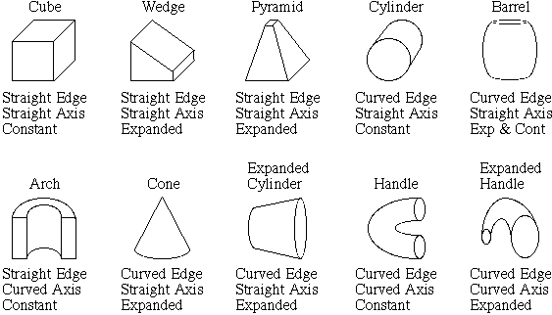

A
B
H
n
O
C
MN
V
D
K
V
C
U
Above each geon is the geon's name. What alphabetic letters does each one suggest? 3700 YA

Slide 17
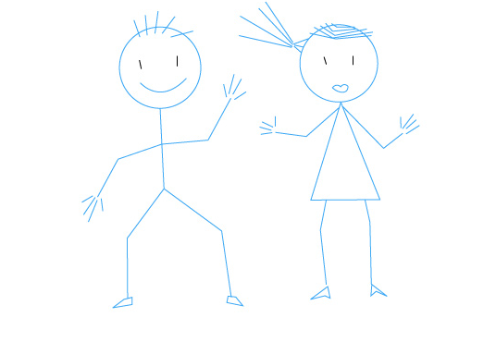
“But, he can’t write.”
The “Drawing-Initial Writing” Connection

Slide 18
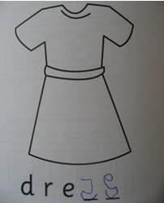

The “Drawing-Initial Writing” Connection
(If s/he can draw, s/he can write.)
B
S

Slide 19
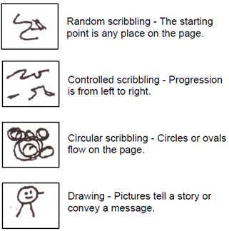
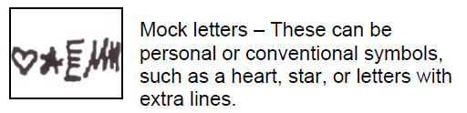
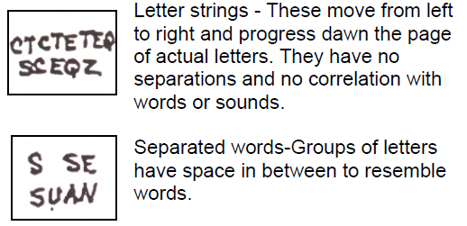
Stages of Writing Development
Prephonemic Stage
(random scribbling, pictures, scribble writing, symbols that represent letters, and actual letters)
(Early emergent: Letter-like forms/
symbolic)
(Preliterate: scribbling = starting
point; directional)
Scribbling → “motor babbling”)
(Emergent: random letters or letter strings)
Temple, Nathan, Temple and Burris, (1992) and D. H. Graves (1989) and
Helen Faul of the California Kindergarten Association.
(Preliterate: drawing)

Slide 20
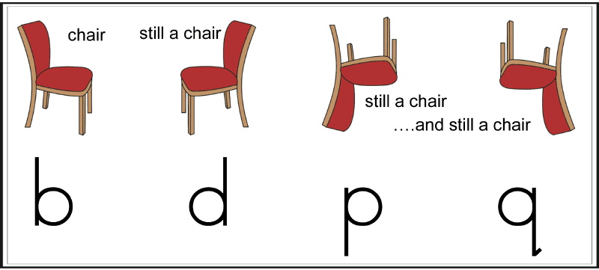
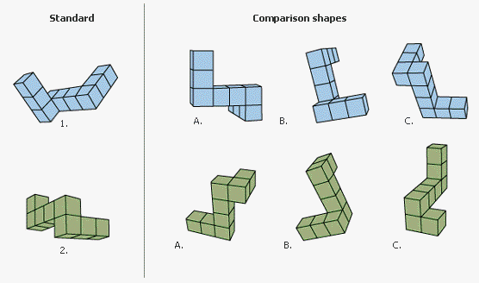
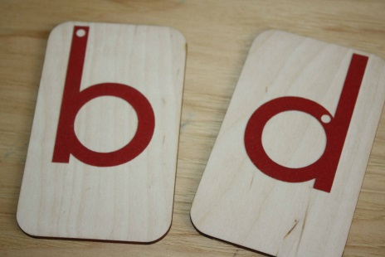
Letter Reversals in Young Children

Slide 21
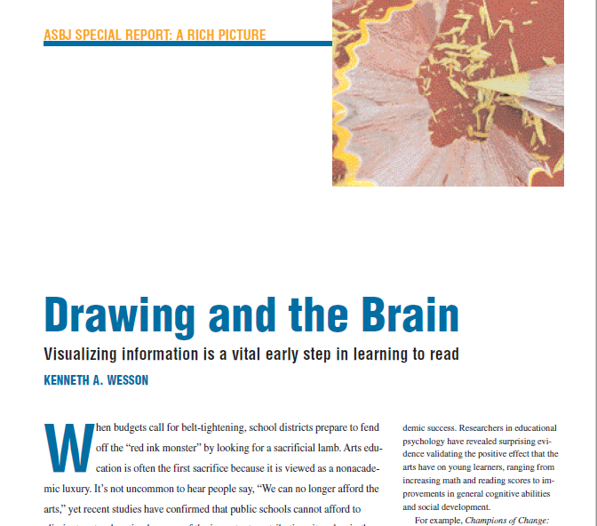
Art and Reading

Slide 22
When taught to generate mental images as they read, students typically experience greater recall and enhanced abilities to draw inferences and make predictions.
(Gambrell, 1981; Gambrell & Bales, 1986; Pressly, 1976; Sadoski, 1983, 1985_)

Slide 23
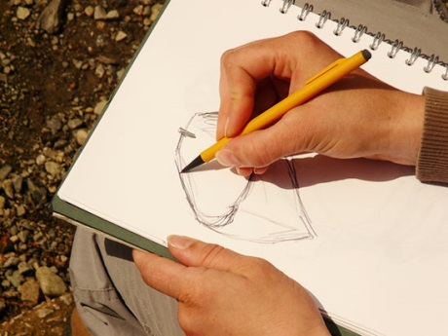
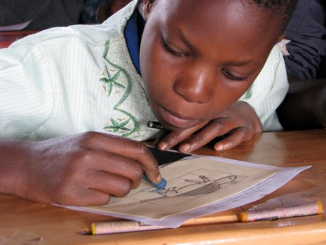

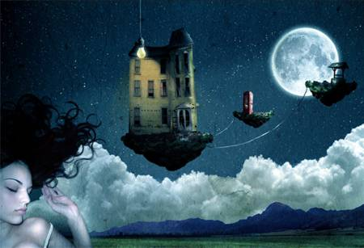
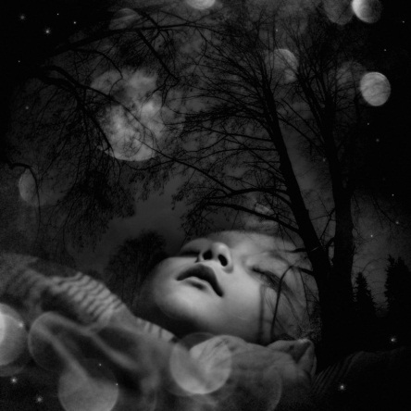

Drawing does for the brain during the day,
what
Dreaming does for the brain at night.

Slide 24
Art and the Brain
If I can… Then I am able to…
1. Mentally visualize a concept Discuss the images that I see inside my “mind’s eye”
2. Discuss the images orally Draw, sketch or paint it
3. Illustrate it Process it on a symbolic level
4. Process my symbol(s) Understand other similar representational forms
5. Understand various Process abstract ideas
representations
6. Hold abstract ideas Understand what others mean, in my mind when describing it
7. Understand what others Read what others write about mean verbally the concept

Slide 25
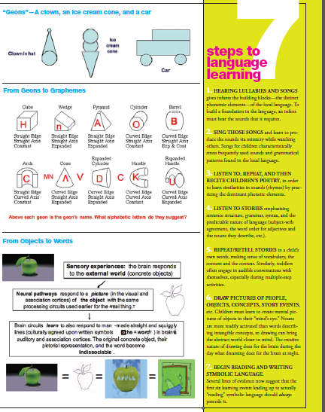

Music

Slide 26

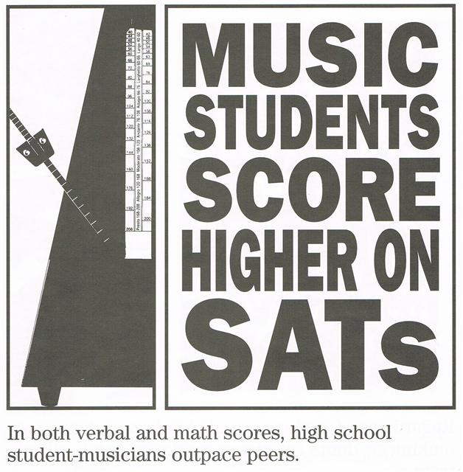
Music students score higher on SATs.
Average 57 points higher in verbal
Average 41 points higher in math
Music majors are better
readers
Music majors are more
successful medical
school applicants

Slide 27
Why Are Some Things
So Pleasing to the Eyes?
Math
Art
Science

Slide 28

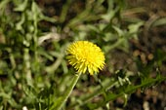



Fibonacci Numbers and Nature
0
1
1
2
3 lilies and iris
5 buttercup, wild rose, larkspur
8 delphiniums
13 ragwort, corn marigold, cineraria, poppy seed head
21 aster, black-eyed susan, chicory
34 daisies, plantain, pyrethrum
55 michaelmas daisies, the asteraceae family
89 daisies, the asteraceae family
144 sunflowers
233
377
610
987

Slide 29
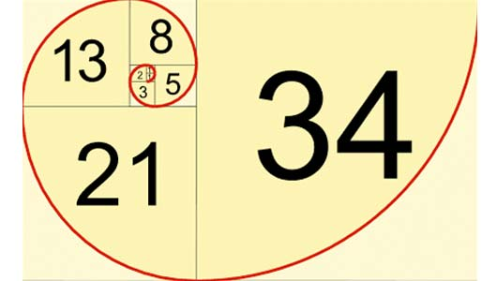

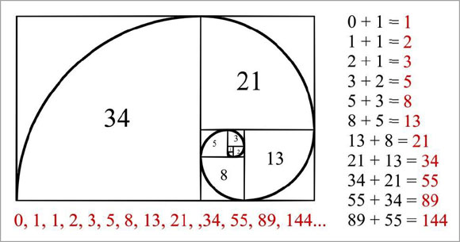
1.618

Slide 30

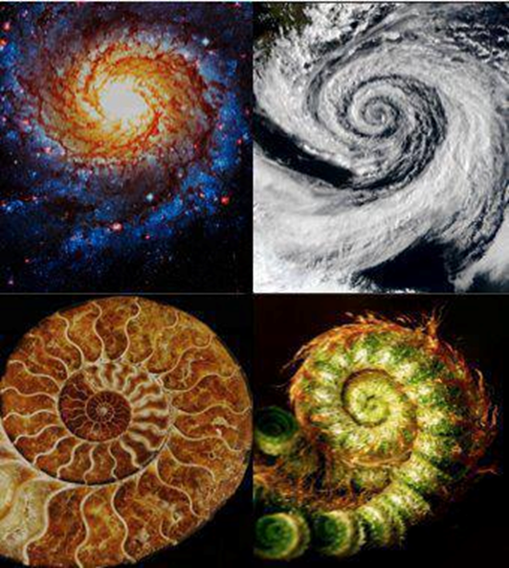
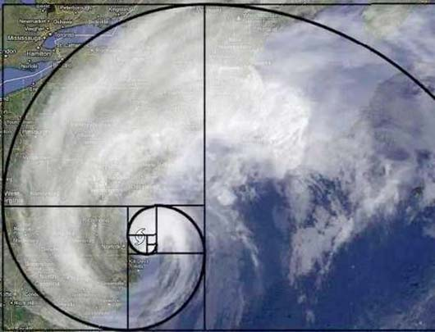
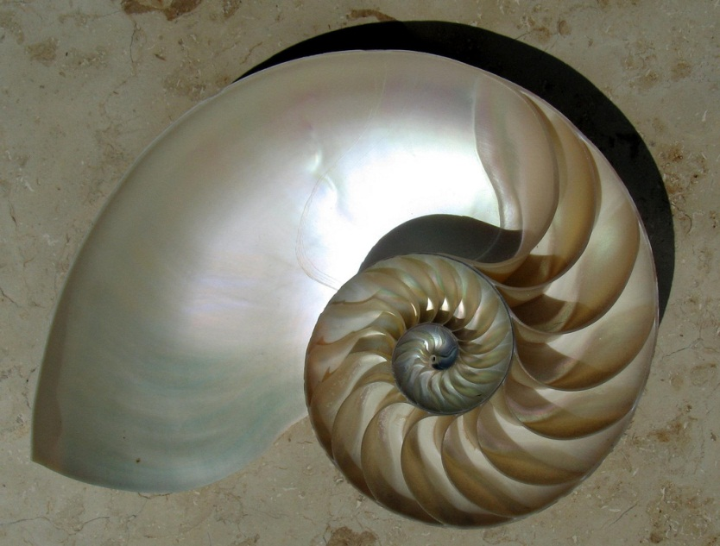

Slide 31
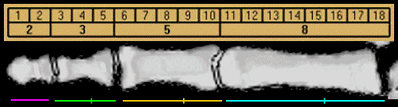
Each section of your index finger, from the tip to the base of the wrist, is larger than the preceding one by about the Fibonacci ratio of 1.618, also fitting the Fibonacci numbers 2, 3, 5 and 8.
By this scale, your fingernail is 1 unit in length. Curiously enough, you also have 2 hands, each with 5 digits, and your 8 fingers are each comprised of 3 sections. All Fibonacci numbers.

Slide 32
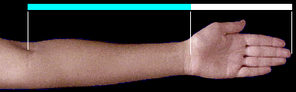
Your hand to forearm is also 1.618
(the “Golden Ratio”).

Slide 33
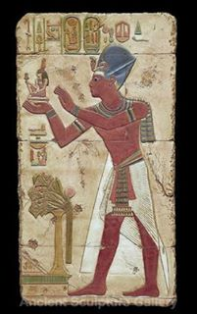
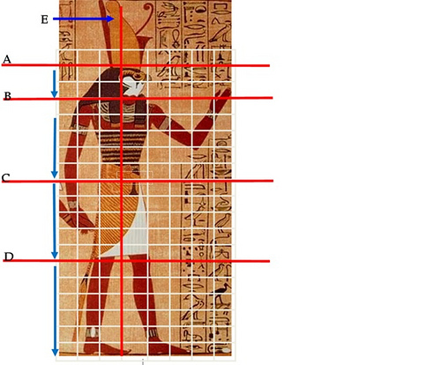

Slide 34
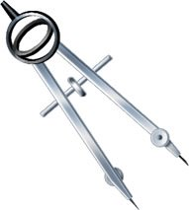
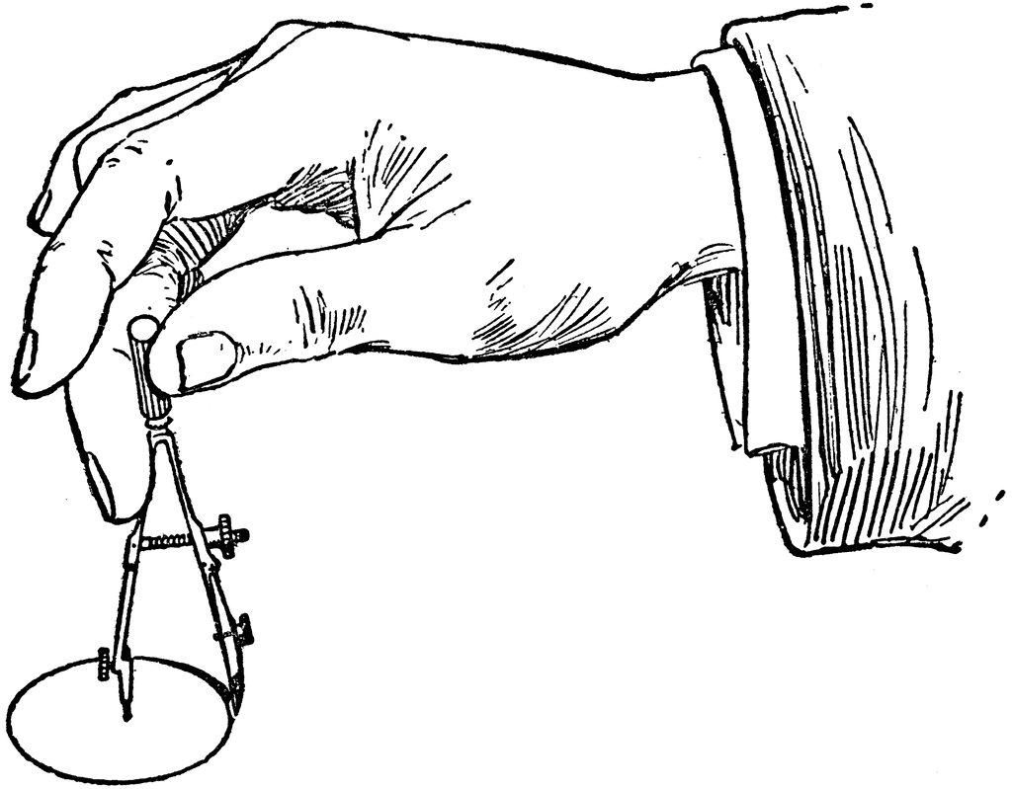
Compass: Art, Math and Creativity

Slide 35
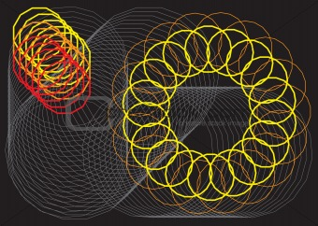

Slide 36
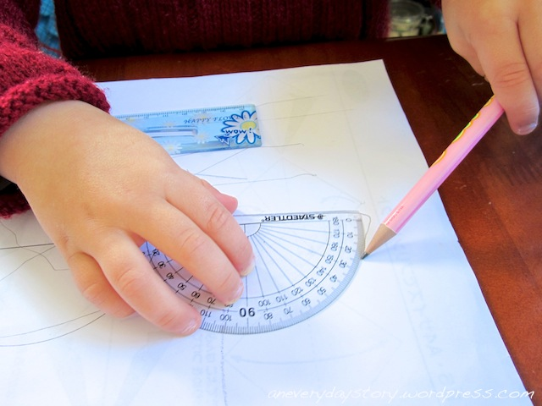
Protractor: Art, Math and Creativity

Slide 37
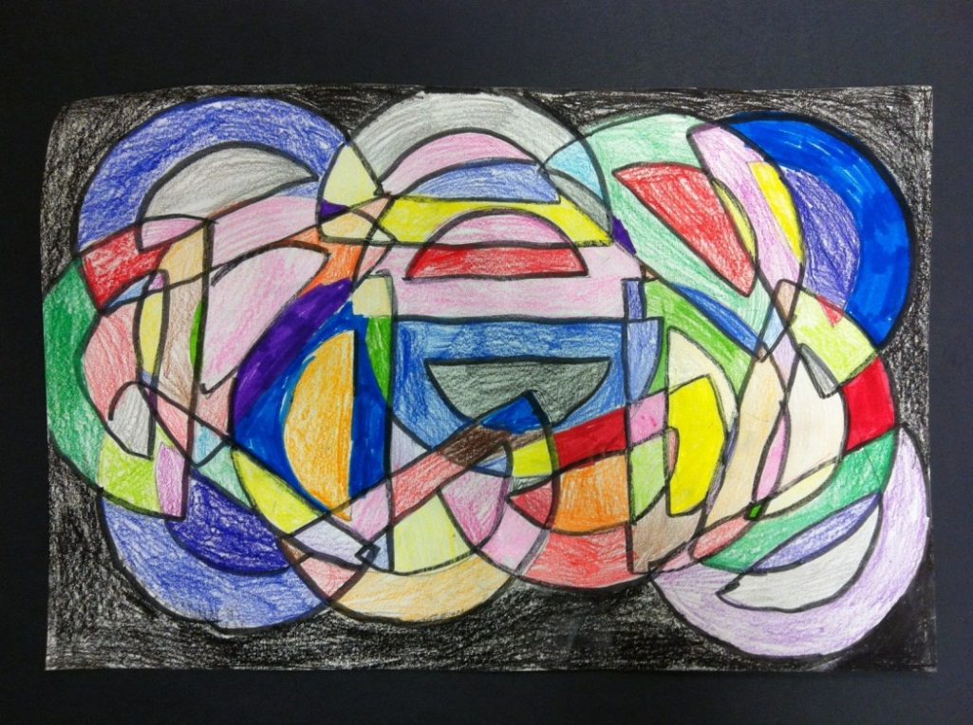
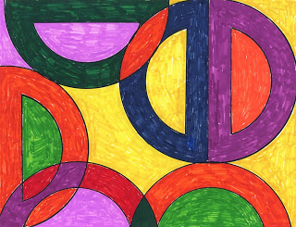



Slide 38


With a compass, protractor, and ruler, wood, nails, and colorful string, students can construct a 2 dimensional pattern in which they will eventually create a colorful artistic expression. They leave the class with an understanding of the mathematical terms: angles, radius, diameter, circumference, center point, and ray.

Slide 39
Combine…
Art + Math + Visualization (VST) + Engineering
(and following oral, written and visual directions)

Slide 40

Origami

Slide 41
S.T.E.A.M.: Why the “A” in STEM?
Art Enhances VST
in Science
and Engineering
(Art 1st Step in Problem solving)

Slide 42

Art deserves inclusion in STEAM because…
Science
Technology
Engineering
Art
Mathematics
(Maximizing connections and sensory experiences)
(“Design and Engineering”)
All engineering begins with a design (→ diagram graphic representation of an initial idea).

Slide 43
STEAM education…
The easiest way to incorporate art and creativity into your curriculum is to identify the art and creativity potential in the content and activities that you are already teaching.
Some content is creativity-ready, but not labeled as such, while other content lends itself towards creativity with just a few minor modifications.

Slide 44

Design and Engineering
Problem/situation: You have received an urgent text message from the Three Little Pigs, who are exasperated with “little pig-provocation” by their neighbor the Big Bad Wolf. You have been asked to engineer two safeguards to prevent further persecution from the Big Bad Wolf.
What design and engineering solution can you propose?

Slide 45

Design & Engineering:
The Three Little Pigs
1. A house with an aluminum rooftop.
2. Replace the chimney with a central heating system
3. Wolves are afraid of snakes, so around the house…
4. Wolves are afraid of water, so install a motion- sensitive automatic water sprinkling system.
5. Build a solar-powered environmentally friendly fan that blows air away from the house, when the wolf blows air towards the house
6. Build a house with a 35° angle rooftop (too steep).
7. Wolves are afraid of water, so build a houseboat and position it 20 yards from the shore.

Slide 46
Design and Engineering:
The Three Little Pigs
NGSS:
“…develop a simple sketch, drawing or physical model to illustrate how you would solve this problem.”
(Achieve, Inc., 2013)

Slide 47





Houseboat Solutions for the Three Little Pigs
“Arte/Scienza”
Only Your Imagination Can Set a Limit on Your Creative Thinking

Slide 48

Emotions Can Become a
Catalyst or an Obstacle to Learning
Afraid to “fail”
“Failure is not an Option”
Failure is nearly always a prerequisite for future learning, success in science and creativity. Most initial learning and discoveries occur via trial-and-error.

Slide 49

In 60 seconds, draw a quick sketch of the person sitting next to you.

Slide 50
Find the picture that looks like you (or the artist can pass it to you, if you don’t recognize yourself in portrait) .
“I’m sorry.”
Would a child ever say that?

Slide 51
Creative Minds and the Brain
Many of history's most prominent scientists were quite accomplished in the arts.
MacArthur “genius” Robert Root-Bernstein, in his book Sparks of Genius, detailed a startling finding.
Researched the lives of 150+ renowned scientists from Pasteur to Einstein, one single common trait:
Nearly all of the greatest scientists, mathematicians, and inventors were also musicians, artists, sculptors or poets.

Slide 52

The “Humanities”
The world’s most distinguished universities
“College of Arts and Science”

Slide 53
Art and the Brain
Art facilitates the development of spatial reasoning skills
Art increases one’s ability to create mental abstractions and to mentally process concepts in the abstract
Art assists students in visualizing the images representing the words as they learn to read
Art develops the fine motor skills that are among the most necessary prerequisites for writing
Art develops patience, sustained attention and self-regulation (controlling impulsivity), all “school readiness” skills
Art is a bridge between one’s mind and the visible world
Art cultivates one of the key “Multiple Intelligences” (Howard Gardner, Harvard University)
Art develops the whole brain and the whole child.

Slide 54

“Reflect and Connect”
• What was the most valuable idea that you learned this morning?
Write down two “I will…” statements. (How will you use this new information or knowledge?)

Slide 55


Art, Creativity and the Human Brain
Contact Information:
Kenneth Wesson
Educational Consultant: Neuroscience
(408) 323-1498 (office)
(408) 826-9595 (cell)
San Jose, CA
Kenawesson@aol.com
sciencemaster.com

